Slide 1

MCA MINI PROJECT — FIRST PRESENTATION
ClauseIQ
Machine Learning-Based Contract Clause Classification and Intelligent Search System
Student: Mohammed Farhan K
Register Number: MAC25MCA-2042
React • FastAPI • Supabase
ClauseIQ | Mini Project First Presentation
01 / 20
Notes:
today I am presenting my MCA Mini Project titled ClauseIQ — Machine Learning-Based Contract Clause Classification and Intelligent Search System.
The main purpose of ClauseIQ is to automatically process legal contracts, classify individual clauses into categories, and help users search for relevant clauses intelligently.
In this project, I am using classical machine learning with TF-IDF for clause classification and cosine similarity for clause search.

Slide 2



THE PROBLEM
Problem & Motivation
Diverse Clause Types
Manual Review is Slow
Keyword Search Falls Short
Parties, License, Liability, Termination and more
Spread across many contracts
Reading every contract takes time
Difficult to scale across large collections
Wording varies across contracts
Exact matches can miss relevant clauses
Need: an automated system to extract, classify, and intelligently search legal clauses within contracts.
ClauseIQ | Mini Project First Presentation
02 / 20
Notes:
Contracts contain many different types of clauses such as confidentiality, liability, termination, and governing law.
When organizations handle many contracts, manually reading and identifying these clauses takes a lot of time.
Another problem is that keyword search is not always effective because the same legal concept can be written in different ways.
Therefore, there is a need for an automated system that can extract contract text, classify clauses, and help users find relevant clauses.

Slide 3







GOALS
Project Objectives
Extract Text from PDF Contracts
Preprocess Clause Text with NLTK
Convert Text to TF-IDF Features
Classify Clauses into CUAD Categories
Compare Multiple ML Classifiers
TF-IDF + Cosine Similarity Search
Build Web Interface — React & FastAPI
Store Data in Supabase PostgreSQL
ClauseIQ | Mini Project First Presentation
03 / 20
Notes:
The first objective is to extract text from uploaded PDF contracts.
Then the extracted clause text is preprocessed using NLTK.
After preprocessing, I convert the text into numerical features using TF-IDF.
Then I will classify clauses into CUAD categories and compare four machine learning algorithms.
The system also provides intelligent search using TF-IDF and cosine similarity.
Finally, the complete system will be integrated with a React frontend, FastAPI backend, and Supabase PostgreSQL.

Slide 4
LITERATURE REVIEW
Summary of Relevant IEEE Journal Papers
Quevedo et al., 2024
Siino et al., 2025
Kutbi, 2023
Systematic Mapping Study — 75 papers reviewed
PRISMA Literature Review — 61 papers reviewed
Experimental Study — own trained model
Surveys Legal-BERT, SVM, LSTM, CNN, GNN and other Legal-NLP methods (2015–2022).
Surveys BERT-family, LLM and GPT-based Legal-NLP approaches (2017–2023).
Linear SVM + Named-Entity replacement preprocessing; 5×10-fold CV; bigram features.
Best cited F1-score*: 0.973
Best cited F1-score*: 75.06
Own reported accuracy: 63.76%
(LegalBERT, Overruling task — a primary study it reviews)
(BERT-based model, outcome prediction — a primary study it reviews)
(Linear SVM + NER, bigram — Kutbi's own experiment, legal LPA dataset)
Broad Legal-NLP survey supporting a classical-ML approach for ClauseIQ.
Frames LLM/RAG as a future extension, the current ClauseIQ system.
Validates that preprocessing choices measurably affect legal-text classification accuracy.
Research Gap: existing work advances Legal NLP with transformer/LLM methods, but ClauseIQ targets a lightweight, practical pipeline — classical ML + TF-IDF classification + TF-IDF/Cosine search — without requiring an LLM as the core classifier. *Cited from a primary study reviewed within that paper — not the review paper's own result.
ClauseIQ | Mini Project First Presentation
04 / 20
Notes:
I reviewed three relevant IEEE papers to understand the existing approaches in Legal NLP and legal text classification.
The first paper by Quevedo et al. is a systematic mapping study covering 75 papers in Legal NLP. It provides a broad understanding of methods such as classical machine learning and deep learning.
The second paper by Siino et al. reviews 61 papers related to LLMs and legal applications. This helped me understand modern Legal NLP approaches and identify LLMs and RAG as possible future enhancements.
The third paper by Kutbi is an experimental study that uses Linear SVM and preprocessing techniques for legal text classification. It reported an accuracy of 63.76%.
These papers helped identify the research gap for ClauseIQ.

Slide 5



EVALUATION STRATEGY
Evaluation Metrics & Research Gap
Planned Evaluation Metrics
Why Macro F1?
Accuracy — overall correctness
The dataset has 41 highly imbalanced categories (46.33:1 ratio). Macro F1 weights every category equally, so rare clause types are not ignored in favor of common ones.
Precision & Recall — per class
F1-score — balance of precision/recall
Macro F1-score — primary metric
Research Gap
A practical, classical-ML pipeline for multi-class clause classification combined with an integrated TF-IDF search layer — without depending on an LLM.
Weighted F1-score — secondary metric
Confusion Matrix — 41-class error analysis
ClauseIQ | Mini Project First Presentation
05 / 20
Notes:
this slide shows the evaluation strategy I will use after training.
I will evaluate the models using Accuracy, Precision, Recall, F1-score, Macro F1-score, Weighted F1-score, and a Confusion Matrix.
My primary metric will be Macro F1-score because the dataset is highly imbalanced.
Macro F1 gives equal importance to every category, including rare categories.
This prevents the model from appearing good only because it predicts the larger categories correctly.

Slide 6
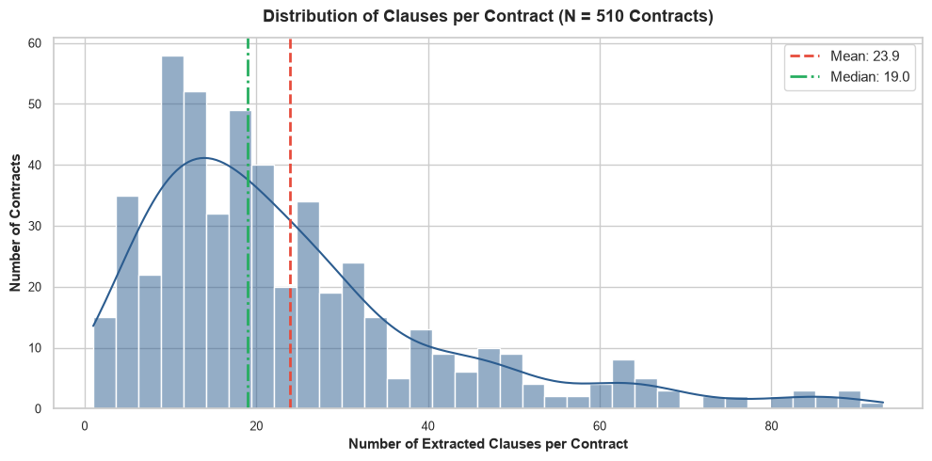
DATASET
Dataset — CUAD-Derived ClauseIQ Dataset
510
41
12,204
3
Clauses per Contract (N = 510)
Contracts
Categories
Rows
Columns
Schema
contract_id
clause_text
category
Source contract ID
Extracted clause text
Ground-truth label
Mean 23.93 • Median 19 • Std Dev 17.88 • Range 1–93
Data Completeness: 0 missing values, 0 empty strings, 0 exact duplicate rows — 100% complete.
1,655 repeated clause texts (13.56%) are legitimate legal boilerplate across contracts, not errors.
ClauseIQ | Mini Project First Presentation
06 / 20
Notes:
For this project, I am using a CUAD-derived processed dataset.
The original dataset contains 510 commercial contracts and 41 clause categories.
My processed dataset contains 12,204 rows and three columns:
contract_id, clause_text, and category.
The dataset has no missing values, no empty strings, and no exact duplicate rows.
There are some repeated clause texts, but these are legitimate legal boilerplate clauses that occur across multiple contracts.

Slide 7
DATA ANALYSIS
EDA — Dataset & Class Distribution
Top 15 Categories by Sample Count (of 41)
1,251
Largest — Parties
27
Smallest — Price Restrictions
46.33 : 1
Imbalance Ratio
31.90%
Top-5 Categories Share
1.59%
Bottom-5 Categories Share
ClauseIQ | Mini Project First Presentation
07 / 20
Notes:
This slide shows the distribution of clause categories.
The dataset contains 41 categories, but they are not equally distributed.
The largest category is Parties with 1,251 samples, while Price Restrictions has only 27 samples.
This gives an imbalance ratio of approximately 46.33 to 1.
Because of this imbalance, I selected Macro F1-score as the primary evaluation metric.

Slide 8
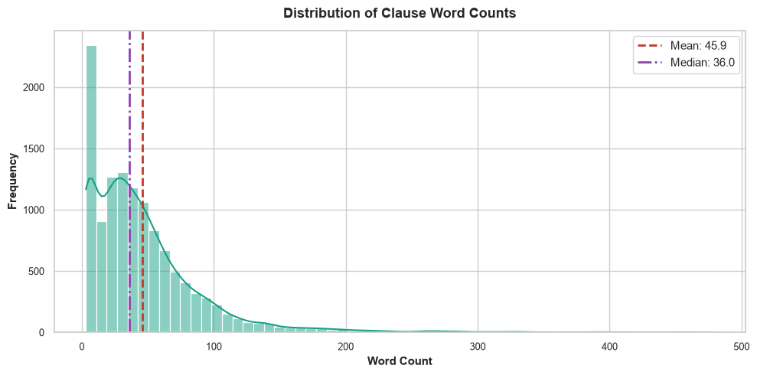
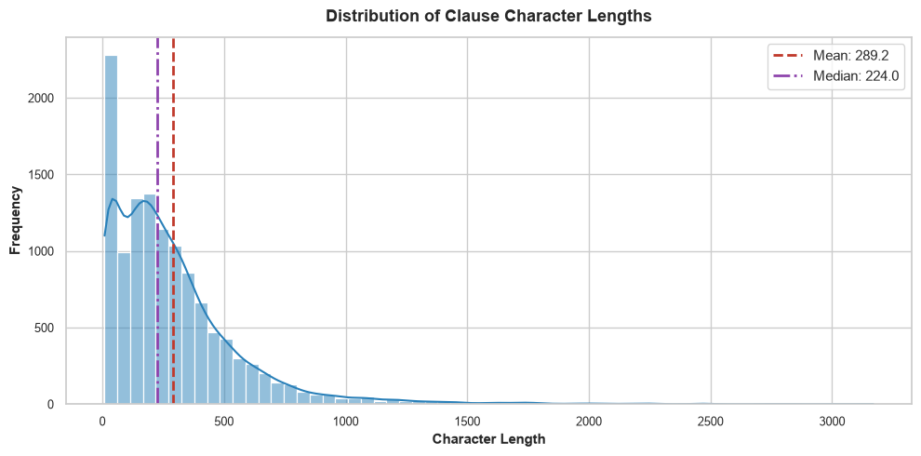
DATA ANALYSIS
EDA — Text & Statistical Analysis
Word Count Distribution
Character Length Distribution
Pearson r = 0.9945 — character length strongly tracks word count
Metric
Word Count
Character Length
Mean
45.89
289.16
Median
36.00
224.00
Std Dev
43.66
277.38
Min / Max
3 / 479
9 / 3,169
ClauseIQ | Mini Project First Presentation
08 / 20
Notes:
Here I analyzed the length of the clause text.
The average clause contains approximately 46 words and around 289 characters.
However, clause lengths vary significantly, with some clauses containing up to 479 words.
I also found a very high correlation of 0.9945 between word count and character length.
This shows that both measurements represent similar information.

Slide 9
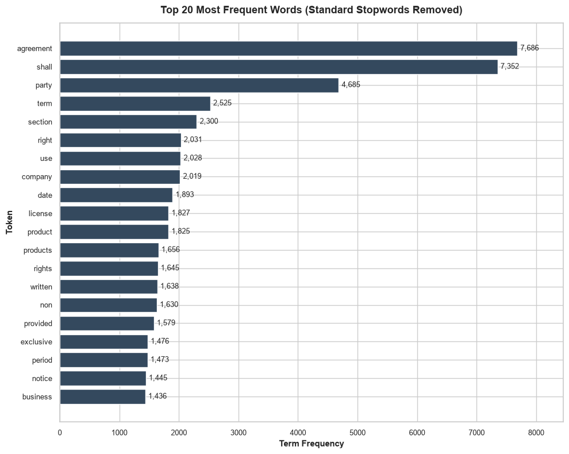
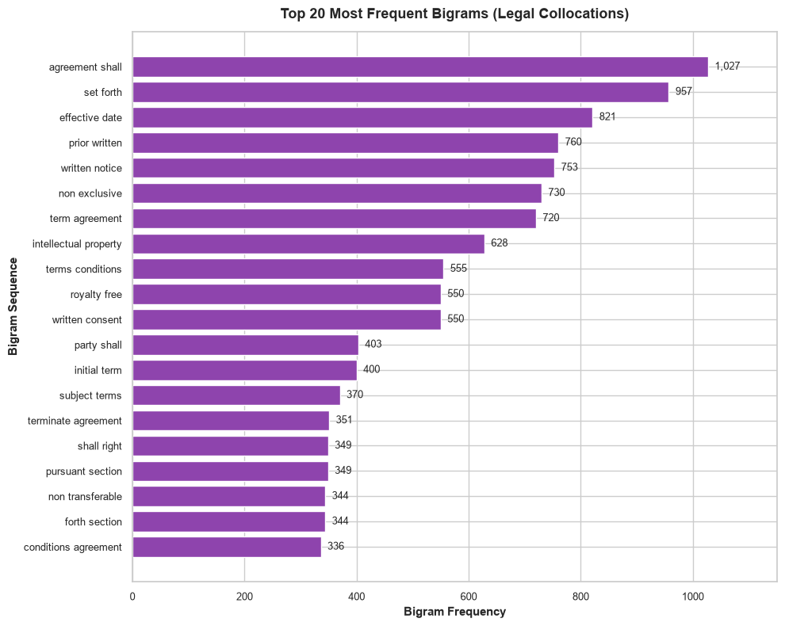
DATA ANALYSIS
EDA — Text & Legal-Term Analysis
Top 20 Frequent Words (Stopwords Removed)
Top 20 Legal Bigrams
11,887 unique tokens across 349,602 processed terms • Bigrams like "written notice" and "intellectual property" carry legal meaning beyond single words.
ClauseIQ | Mini Project First Presentation
09 / 20
Notes:
In this slide, I analyzed the most frequent words and legal phrases in the dataset.
After removing stopwords, I identified important legal vocabulary.
I also analyzed bigrams, which are two-word phrases, such as "written notice" and "intellectual property".
These phrases can carry more legal meaning than individual words.
Therefore, this analysis supports using both unigrams and bigrams in the TF-IDF representation.

Slide 10
FEATURE ENGINEERING
Preprocessing & TF-IDF
Raw
Text
→
Lowercase
→
Remove
Punctuation
→
Stopword
Removal
→
Tokenization
→
Lemmatization
→
TF-IDF
Preprocessing implemented using NLTK.
Planned TF-IDF Configuration (not yet trained)
ngram_range = (1, 2)
sublinear_tf = True
Captures legal phrases like "written notice"
Dampens influence of very long clauses
max_df = 0.85
min_df = 3
Suppresses ubiquitous terms like "shall"
Removes rare typos / one-off terms
ClauseIQ | Mini Project First Presentation
10 / 20
Notes:
Before giving the text to the machine learning model, I preprocess the clause text.
First, I convert the text to lowercase.
Then I remove punctuation and unnecessary special characters.
After that, I remove stopwords, tokenize the text, and perform lemmatization.
Finally, I convert the processed text into TF-IDF numerical features.
Explain ngram_range = (1,2):
This means the model considers both individual words and two-word phrases.
Explain sublinear_tf:
It reduces the excessive influence of words that occur many times.
Explain max_df:
It filters terms that occur in too many documents and therefore may not be useful for distinguishing categories.
Explain min_df:
It filters extremely rare terms that may not generalize well.

Slide 11
ALGORITHM 1 OF 4
Logistic Regression
Workflow
Principle
A linear classification model that estimates class probabilities for the multiclass problem.
Clause Text
Input → Output
↓
TF-IDF feature vector → predicted clause category
Preprocessing
↓
Why Suitable for Text
TF-IDF Vector
Works well on high-dimensional sparse text features like TF-IDF.
↓
Logistic Regression
Advantage
Fast to train, interpretable coefficients, strong baseline.
↓
Class Probabilities
Limitation
↓
Assumes a linear decision boundary between classes.
Predicted Category
Contribution to ClauseIQ
Serves as the fast, explainable baseline classifier for clause categories.
ClauseIQ | Mini Project First Presentation
11 / 20
Notes:
The first algorithm is Logistic Regression.
It is a linear classification algorithm that estimates class probabilities.
The clause text is preprocessed and converted into a TF-IDF vector.
Logistic Regression then predicts the most likely clause category.
It is fast, interpretable, and works well with high-dimensional sparse data.
Therefore, I am using it as a strong baseline model.
Why Choose
Logistic Regression calculates the probability that a clause belongs to each legal category and selects the category with the highest probability. I chose it because it is fast and performs well for TF-IDF-based text classification.

Slide 12
ALGORITHM 2 OF 4
Linear SVM
Workflow
Principle
Finds the maximum-margin hyperplane separating clause categories.
Clause Text
Input → Output
↓
TF-IDF feature vector → predicted clause category
Preprocessing
↓
Why Suitable for Text
TF-IDF Vector
Excels in high-dimensional, sparse feature spaces such as TF-IDF text.
↓
Linear SVM
Advantage
Often effective for high-dimensional text classification; a strong candidate for sparse TF-IDF features.
↓
Decision Boundary
Limitation
↓
Training can be slower on very large datasets; less interpretable.
Predicted Category
Contribution to ClauseIQ
To be evaluated as a candidate model — not assumed to be the best performer.
ClauseIQ | Mini Project First Presentation
12 / 20
Notes:
The second algorithm is Linear Support Vector Machine, or Linear SVM.
Its main objective is to find a decision boundary that separates the categories with the maximum margin.
It is particularly suitable for high-dimensional and sparse text data.
Since TF-IDF creates sparse feature vectors, Linear SVM is a strong candidate.
However, it can be less interpretable and may require more training time.
I will evaluate it and compare its performance with the other models.
Why Choose:
SVM finds the optimal boundary between different clause categories. I chose it because legal text converted using TF-IDF creates many features, and SVM performs well with high-dimensional text data

Slide 13
ALGORITHM 3 OF 4
Multinomial Naive Bayes
Workflow
Principle
Applies Bayes' theorem assuming feature independence given the class.
Clause Text
Input → Output
↓
TF-IDF feature vector → predicted clause category
Preprocessing
↓
Why Suitable for Text
TF-IDF Vector
Naturally suited to word/term frequency-style text features.
↓
Class Probability Estimation
Advantage
Extremely fast to train; performs well with limited data.
↓
Highest Probability Class
Limitation
↓
Independence assumption can limit accuracy on nuanced text.
Predicted Category
Contribution to ClauseIQ
Included as a fast, lightweight baseline for comparison against the other classifiers.
ClauseIQ | Mini Project First Presentation
13 / 20
Notes:
The third algorithm is Multinomial Naive Bayes.
It is a probabilistic classifier based on Bayes' theorem.
It estimates the probability of each class and predicts the class with the highest probability.
Its main advantage is that it is extremely fast and lightweight.
However, it assumes that features are independent, which is not always true in real text.
I am using it as a simple baseline for comparison.
Why Choose:
Naive Bayes predicts the category based on the probability of words appearing in different categories. I chose it because it is lightweight, fast, and provides a good baseline for text classification.

Slide 14
ALGORITHM 4 OF 4
Random Forest
Workflow
Principle
Ensemble of decision trees; predictions combined by majority vote.
Clause Text
Input → Output
↓
TF-IDF feature vector → predicted clause category
Preprocessing
↓
Why Suitable for Text
TF-IDF Vector
Captures non-linear feature interactions missed by linear models.
↓
Multiple Decision Trees
Advantage
Can reduce overfitting through ensemble learning and capture feature interactions.
↓
Voting
Limitation
↓
Larger model size; less interpretable; can be slower at scale.
Predicted Category
Contribution to ClauseIQ
Tests whether non-linear modeling improves over linear baselines.
ClauseIQ | Mini Project First Presentation
14 / 20
Notes:
The fourth algorithm is Random Forest.
Random Forest is an ensemble learning algorithm.
Instead of using one decision tree, it uses multiple trees.
Each tree makes a prediction, and the final prediction is selected through majority voting.
It can capture some non-linear relationships between features.
However, it requires more memory and is less interpretable than simpler linear models.
I am including Random Forest to test whether non-linear modeling improves performance compared to linear models.
Why Choose:
Random Forest combines multiple Decision Trees and uses majority voting for the final prediction. I chose it to compare a tree-based algorithm with the other text classification algorithms and evaluate whether it can capture useful patterns in the dataset.

Slide 15
MODEL SELECTION
Model Comparison & Selection Strategy
Algorithm | Training Speed | TF-IDF Suitability | Interpretability | Sparse Features | Imbalance Support
Logistic Regression | Fast | High | High | High | Yes — balanced
Linear SVM | Moderate | Very High | Medium | Very High | Yes — balanced
Naive Bayes | Very Fast | High | High | High | Limited
Random Forest | Moderate | Medium | Medium | Medium | Yes — balanced
Train All
4 Models
→
Evaluate on
Same Split
→
Compare Macro F1,
Weighted F1, P/R
→
Analyze Confusion
Matrix
→
Select Best
Model
Best Model: To Be Determined After Training
ClauseIQ | Mini Project First Presentation
14 / 20
Notes:
Instead of assuming which algorithm is best, I will train all four models using the same dataset split and feature representation.
Then I will evaluate them using Macro F1, Weighted F1, Precision, Recall, and the Confusion Matrix.
After comparing the results, I will select the best model.
At this stage, the best model is still to be determined because the final training and evaluation have not been completed.

Slide 16
SYSTEM DESIGN
ML Model Training Pipeline
Offline / one-time process — runs before the application serves any predictions
CUAD Dataset
↓
Data Preparation
↓
NLTK Preprocessing
Lowercase
Punctuation Removal
Stopword Removal
Tokenization
Lemmatization
↓
TF-IDF Feature Extraction
↓
Train Four ML Models
Logistic Regression
Linear SVM
Multinomial NB
Random Forest
↓
Model Evaluation (Planned Metrics)
Accuracy
Precision
Recall
F1
Macro F1
Weighted F1
Confusion Matrix
↓
Model Comparison
↓
Best Model Selection
↓
Selected Model (After Training & Evaluation)
ClauseIQ | Mini Project First Presentation
15 / 20
Notes:
This slide shows the machine learning training pipeline.
This process happens offline and separately from the live application.
First, the CUAD-derived dataset is prepared and preprocessed using NLTK.
Then TF-IDF extracts numerical features.
The same features are used to train four different machine learning algorithms.
After training, the models are evaluated and compared.
Finally, the best-performing model will be selected.

Slide 17



SYSTEM DESIGN
System Architecture — Prediction & Search
User
→
React.js Frontend
→
FastAPI Backend
Classification Module
Search Module — TF-IDF + Cosine Similarity
PDF Extraction (PyMuPDF)
Query Preprocessing
↓
↓
Clause Splitting
TF-IDF Vectorization
↓
↓
NLTK Preprocessing
Compare with Clause Vectors
↓
↓
TF-IDF Transformation
Cosine Similarity
↓
↓
Selected Trained ML Model
Rank Relevant Clauses
↓
↓
Predicted Clause Category
Search Results
Supabase PostgreSQL — Data Persistence Layer: contracts, clauses, predicted categories, model score (where available), searchable data
ClauseIQ | Mini Project First Presentation
16 / 20
Notes:
This slide shows the live system architecture.
The user interacts with the system through the React frontend.
Requests are sent to the FastAPI backend.
The system then has two separate modules: the Classification Module and the Search Module.
Classification module:
For classification, the uploaded PDF is processed using PyMuPDF.
The extracted text is split into clauses.
Each clause is preprocessed using NLTK and converted into TF-IDF features.
The selected trained model predicts the clause category.
Search module:
For search, the user enters a query.
The query is preprocessed and converted into a TF-IDF vector.
Cosine similarity compares the query with clause vectors.
The most relevant clauses are ranked and displayed.
Database:
Supabase PostgreSQL is the data persistence layer for contracts, clauses, categories, model scores where available, and searchable data.

Slide 18








WRAP-UP
Technology, Expected Output & Future Scope
Current Technology Stack
React.js
FastAPI
Python
NLTK
scikit-learn
PyMuPDF
Pandas / NumPy
Supabase PostgreSQL
Expected Output Workflow
Contract
Upload
→
Clause
Classification
→
Search
Query
→
Ranked
Results
Future Enhancements (not part of current system)
LLM Integration
RAG
Multilingual Contracts
Clause Summarization
Legal Chatbot
Cloud Deployment
Contact / questions welcome — thank you.
ClauseIQ | Mini Project First Presentation
19 / 20
Notes:
The technology stack includes React.js, FastAPI, Python, NLTK, scikit-learn, PyMuPDF, Pandas, NumPy, and Supabase PostgreSQL.
The expected workflow is simple:
The user uploads a contract, the system classifies its clauses, and the user can search for relevant clauses.
For future work, I plan to explore LLM integration, RAG, multilingual support, contract summarization, a legal chatbot, and cloud deployment.
These future technologies are not part of the current ClauseIQ classification system.

Slide 19
PROJECT STATUS
Project Development Timeline
1
Problem &
Objectives
→
2
Literature
Review
→
3
Dataset &
EDA
→
4
Preprocessing
& TF-IDF
✓ Completed
✓ Completed
✓ Completed
✓ Completed
↓
5
ML Model
Development
→
6
Training &
Evaluation
→
7
System
Integration
→
8
Testing &
Finalization
✓ Completed
● Current / Next Phase
○ Planned
○ Planned
✓ Completed ● Current / Next Phase ○ Planned
Model training and evaluation is the current / next phase — results are not yet available.
ClauseIQ | Mini Project First Presentation
20 / 20
Notes:
This slide shows the overall development progress of ClauseIQ. We have completed problem identification, literature review, dataset analysis, preprocessing, and ML model development. Currently, the project is moving to the training and evaluation phase. After selecting the best model, the next steps are system integration, testing, and finalization.

